Slide 1
Wildlife Management
Kansas Game Birds

Slide 2
Wildlife Income Kansas
$73 to hunt pheasant and quail
$47.50 to hunt turkey
$322 to purchase a deer tag

Slide 3
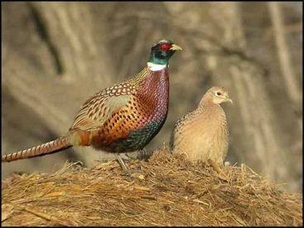

Slide 4
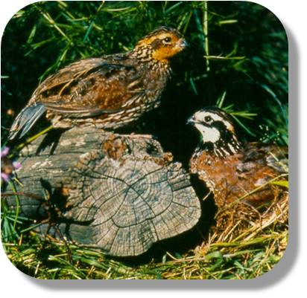

Slide 5
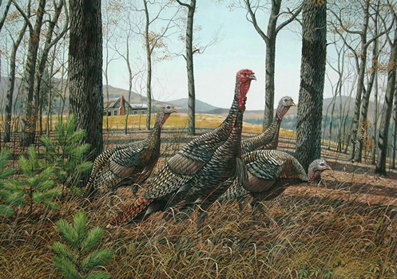

Slide 6
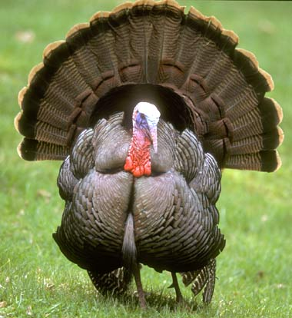

Slide 7
Exit Card
1. What is the name of one of the game bird species in Kansas?
2. What is one of the types of habitat required for game birds in Kansas?
3. How much will an eco-tourist have to pay in order to hunt pheasant and quail in Kansas?
4. What is another name of type of game bird in Kansas?
5. Why are game birds important to Kansas and why should you care about them?

